Slide 1
The Roofing Industry Today and Tomorrow
McKay Daniels
CEO
National Roofing Contractors Association

Slide 2
Economy
Interest rates?
Inflation cooling? Rising?
Washington DC actions?
Nobody knows anything for certain beyond three months… and even that is dubious…

Slide 3
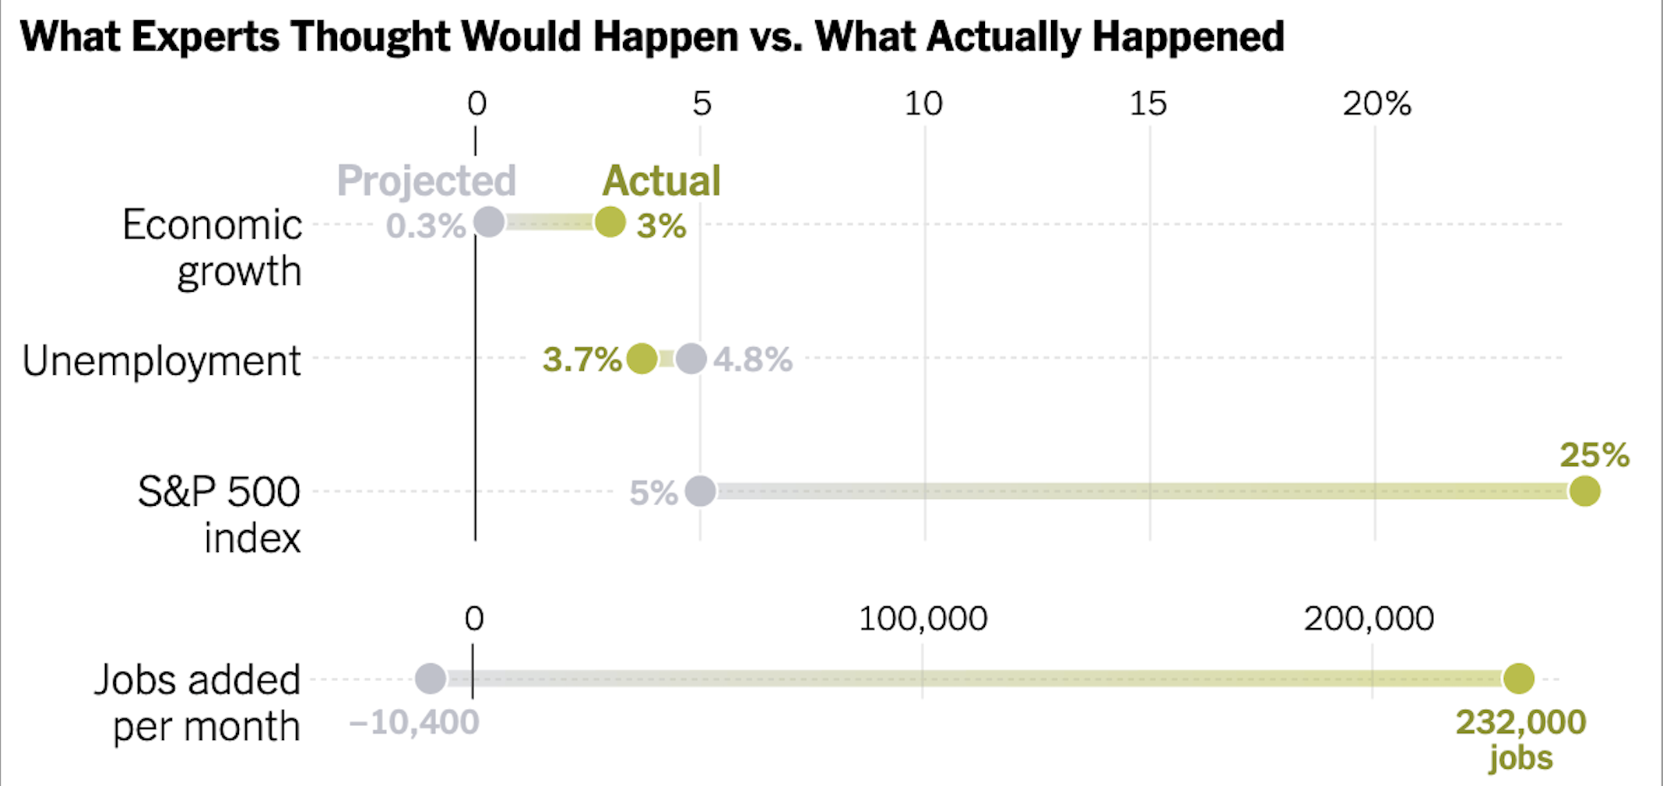

Slide 4
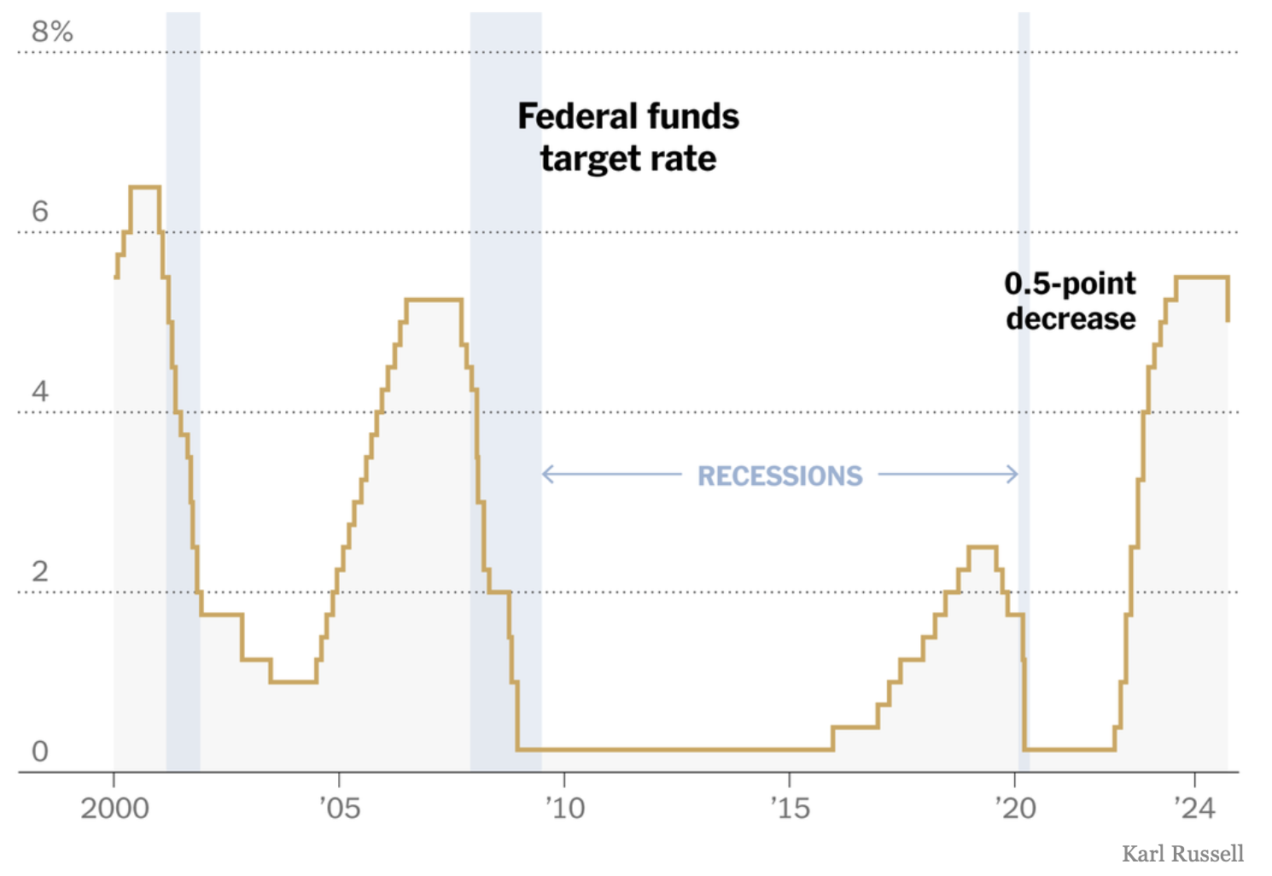

Slide 5
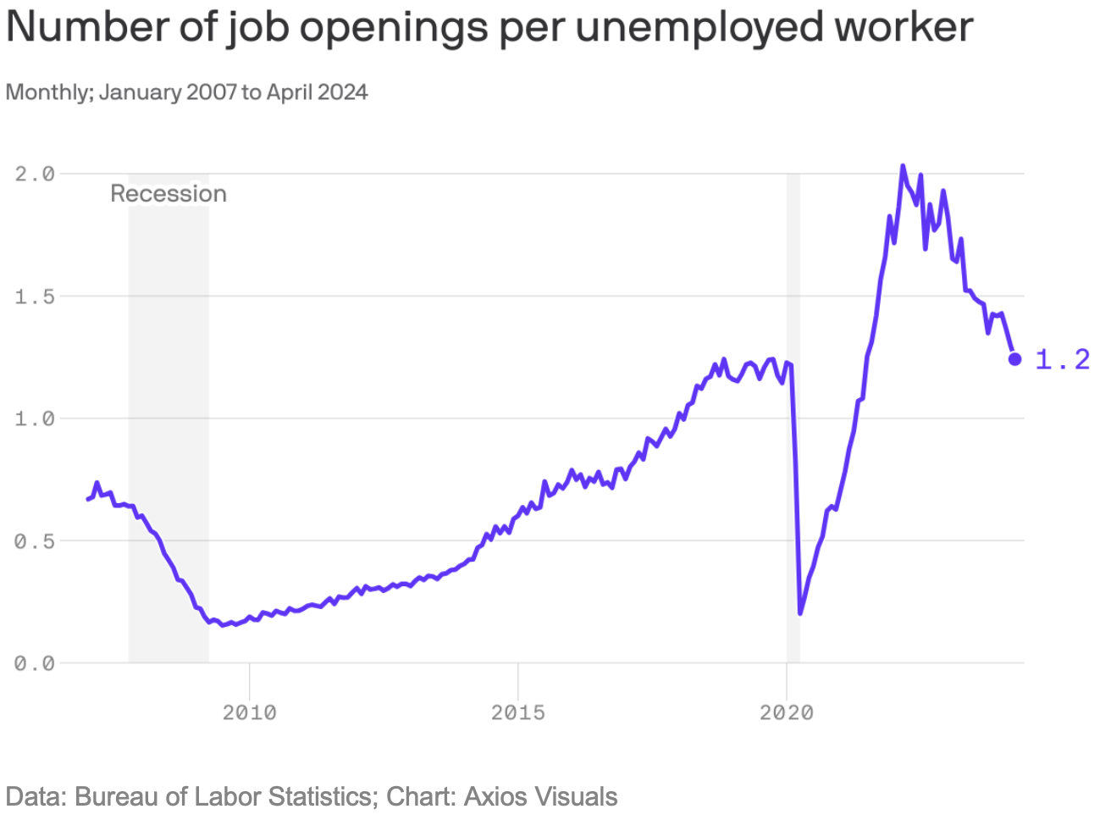

Slide 6
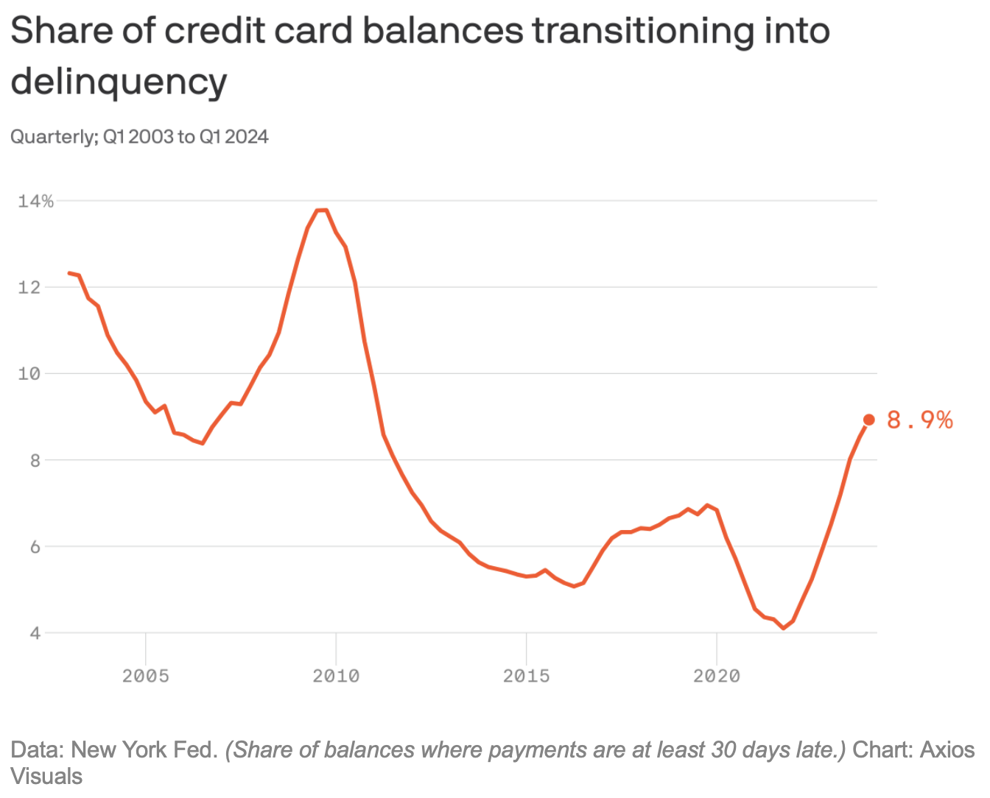

Slide 7
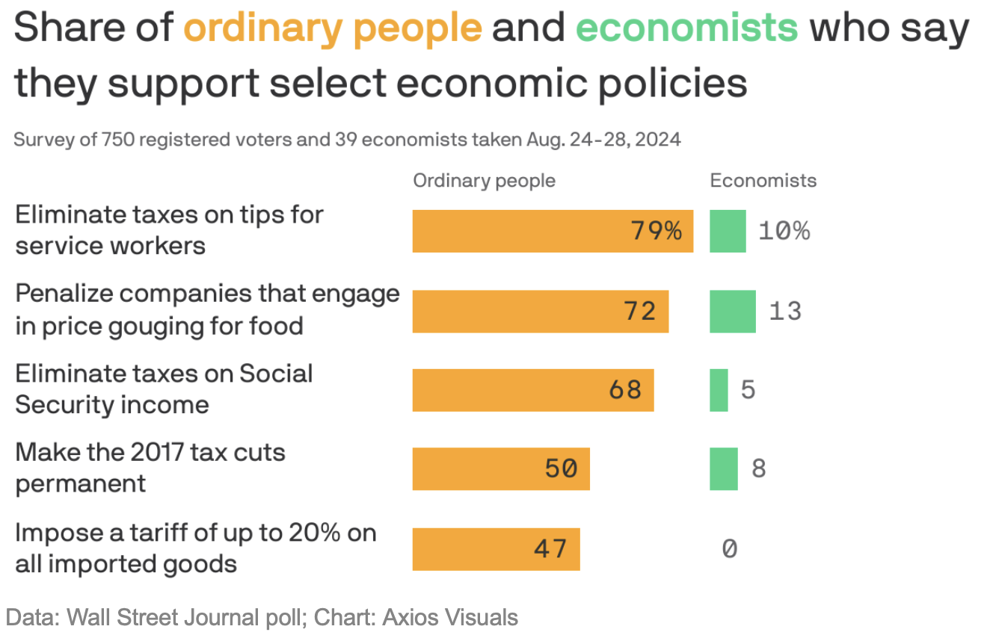

Slide 8
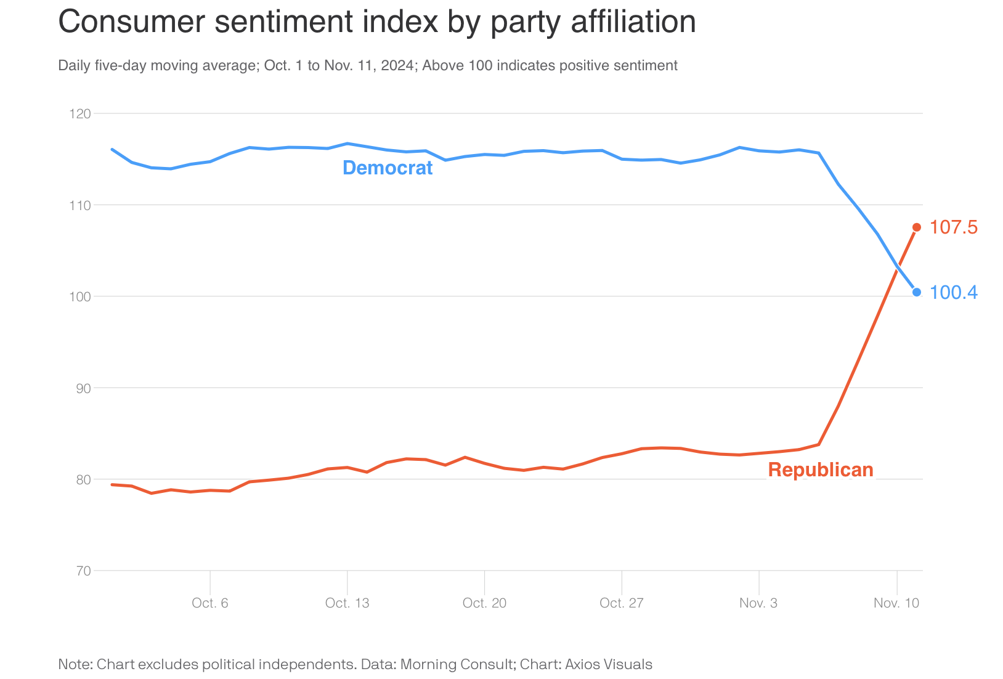

Slide 9
Industry
Stable/strong/mild depending on geography
Work tightening
Macro trends remain: Subs and Workforce, Consolidation, Insurance/Weather
Personal Engagement

Slide 10
Inquiries/Bids

Slide 11
Contracts Signed

Slide 12
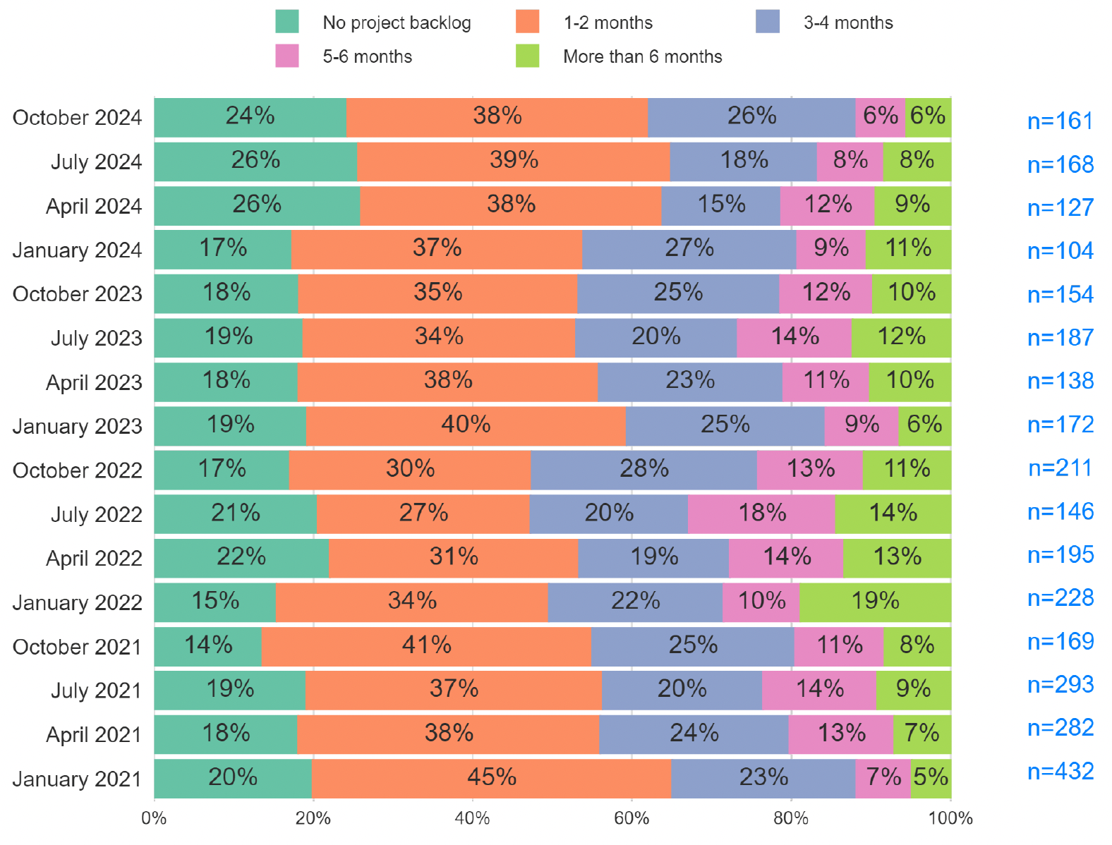
Reroofing Contracts Index
(~% saying increase y/y)

Slide 13
Government Impact on Industry

Slide 14
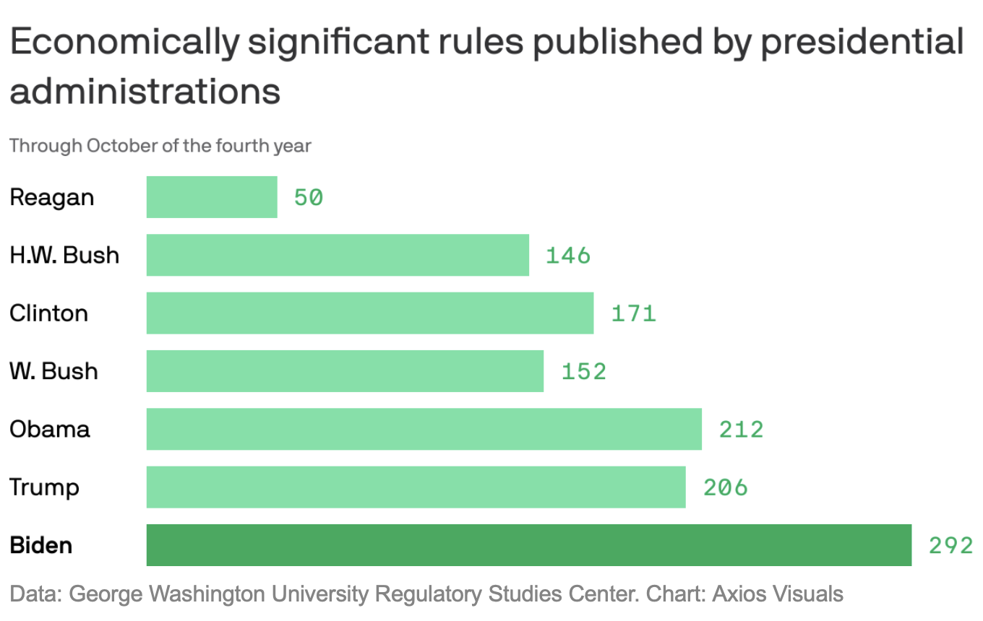

Slide 15
Planned Federal Investment: CHIPS, BIL, IRA ~$500,000,000,000

Slide 16
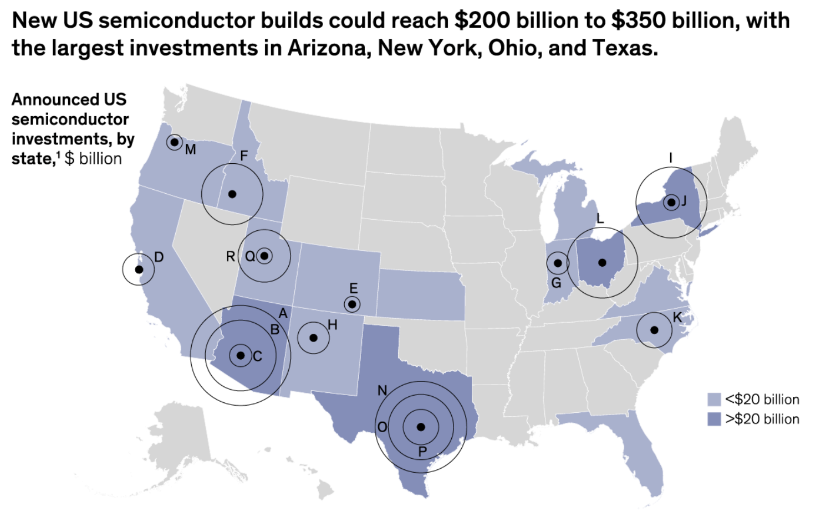

Slide 17
Workforce

Slide 18
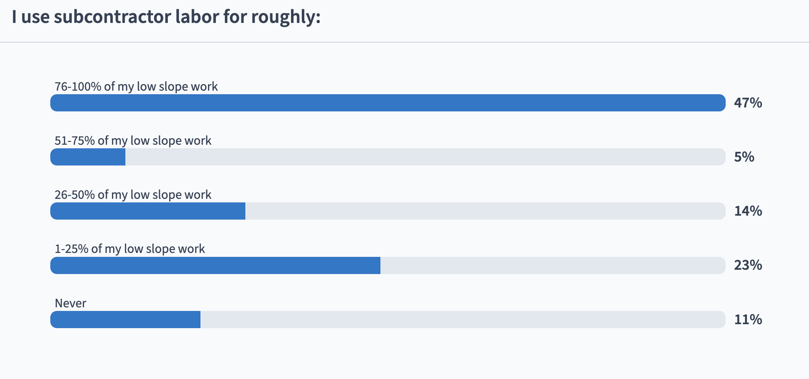

Slide 19
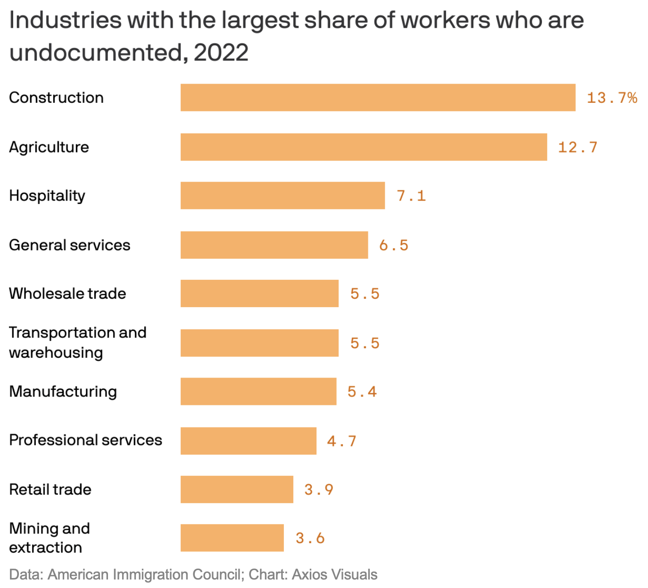

Slide 20
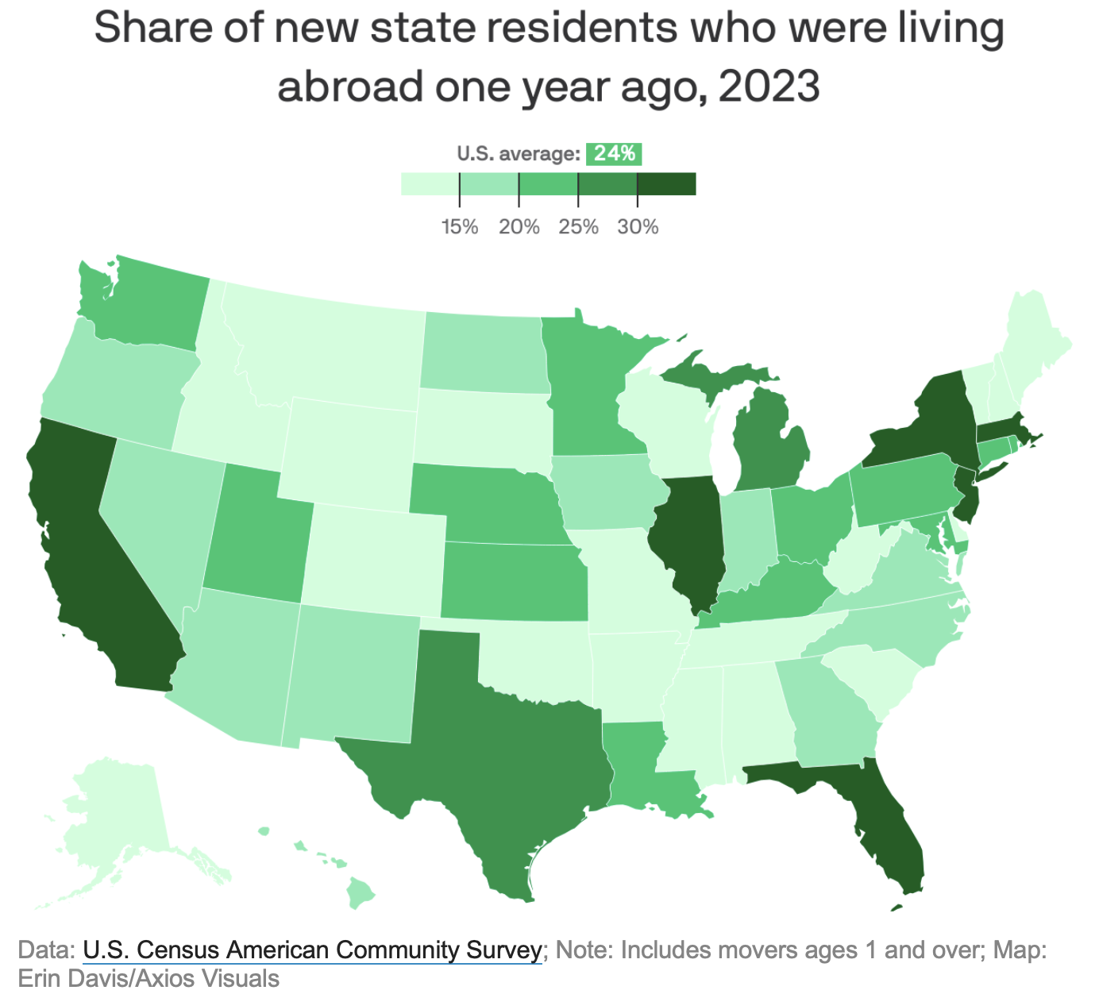

Slide 21
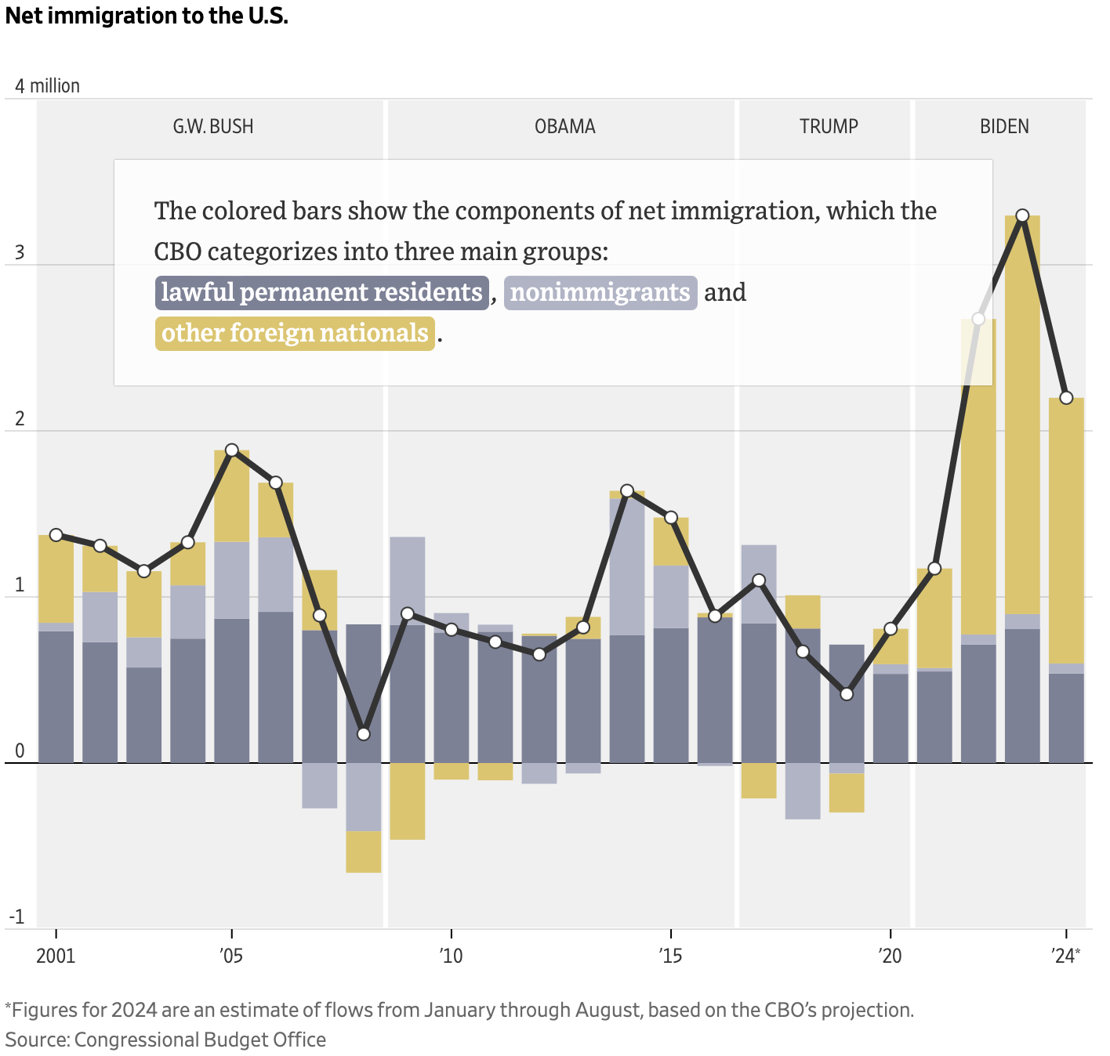

Slide 22
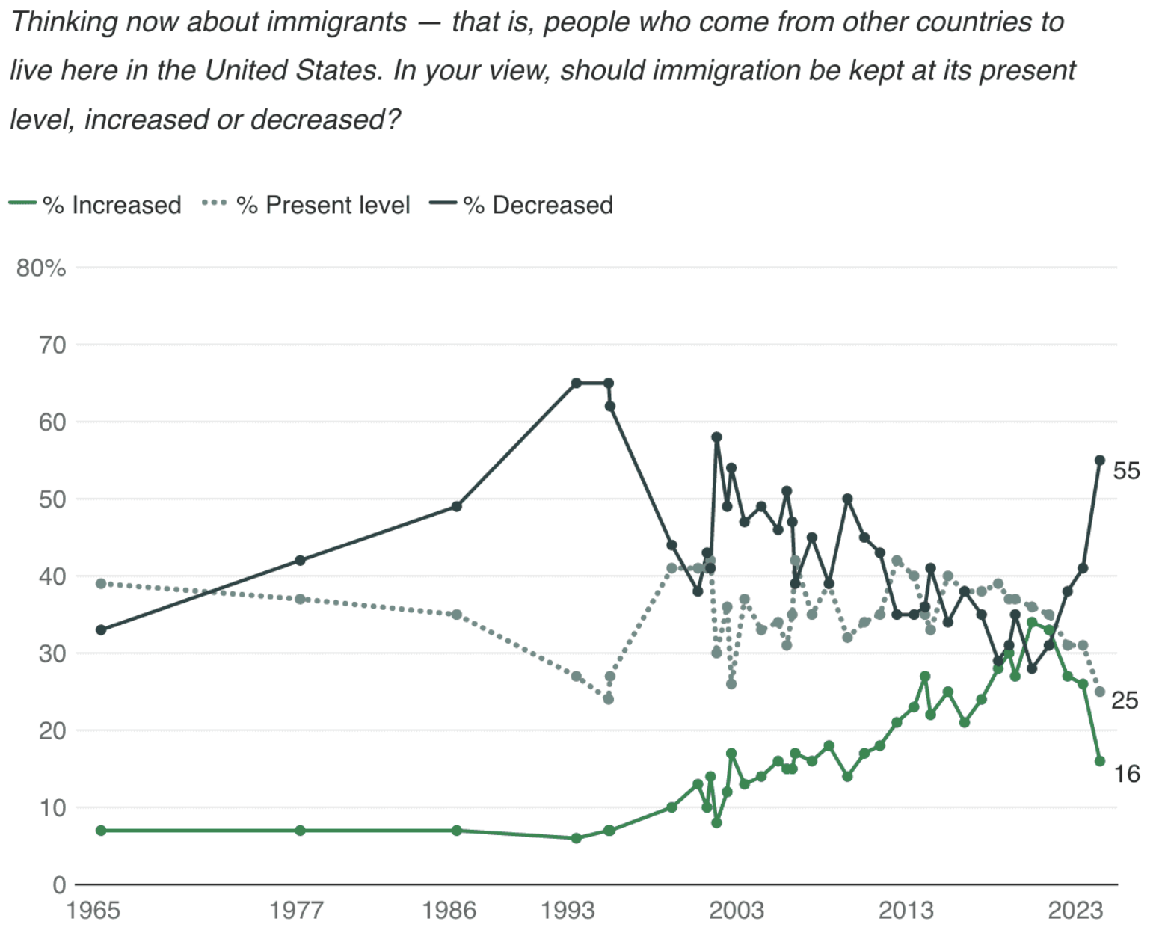

Slide 23
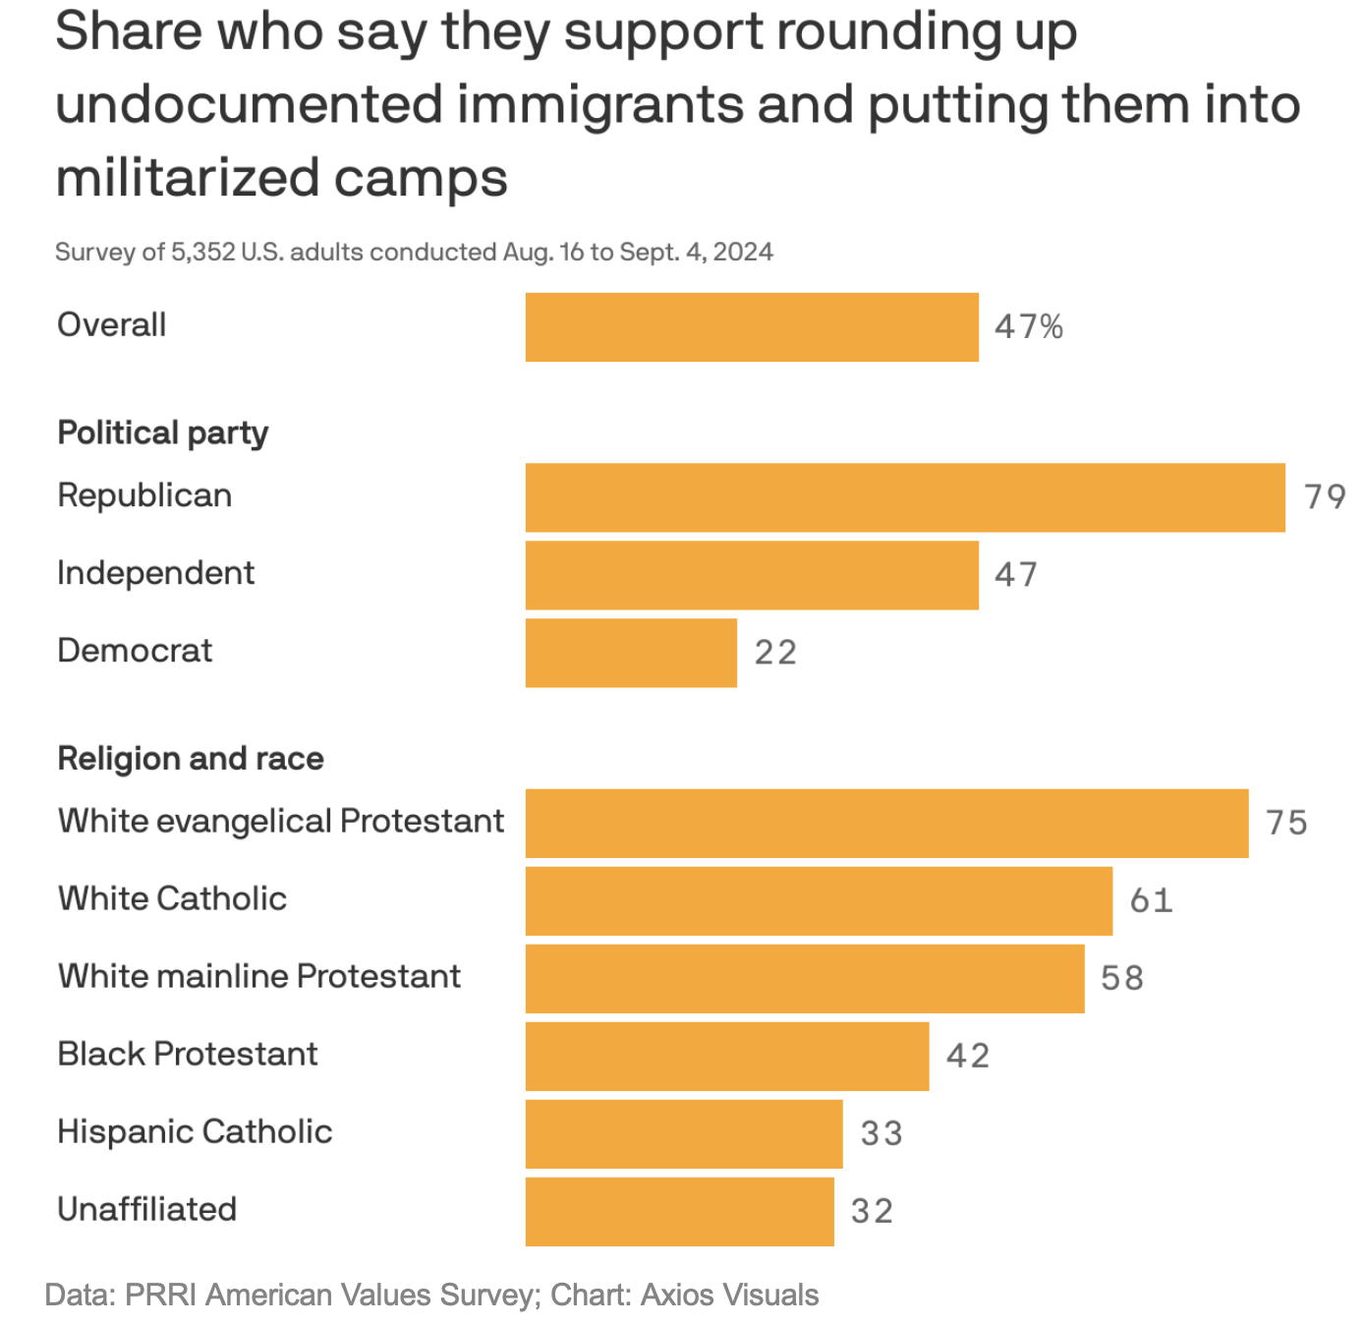

Slide 24
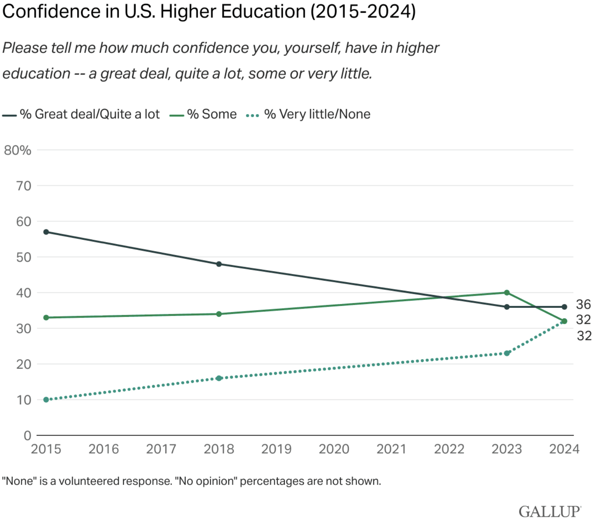

Slide 25
Insurance

Slide 26
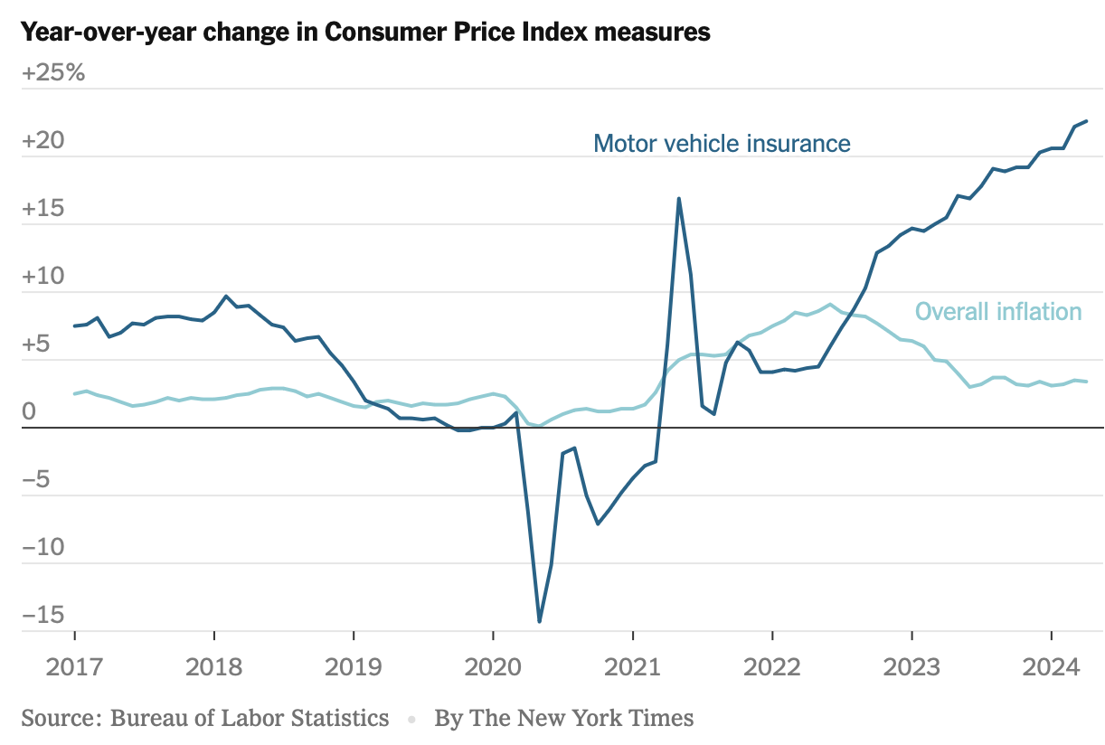

Slide 27
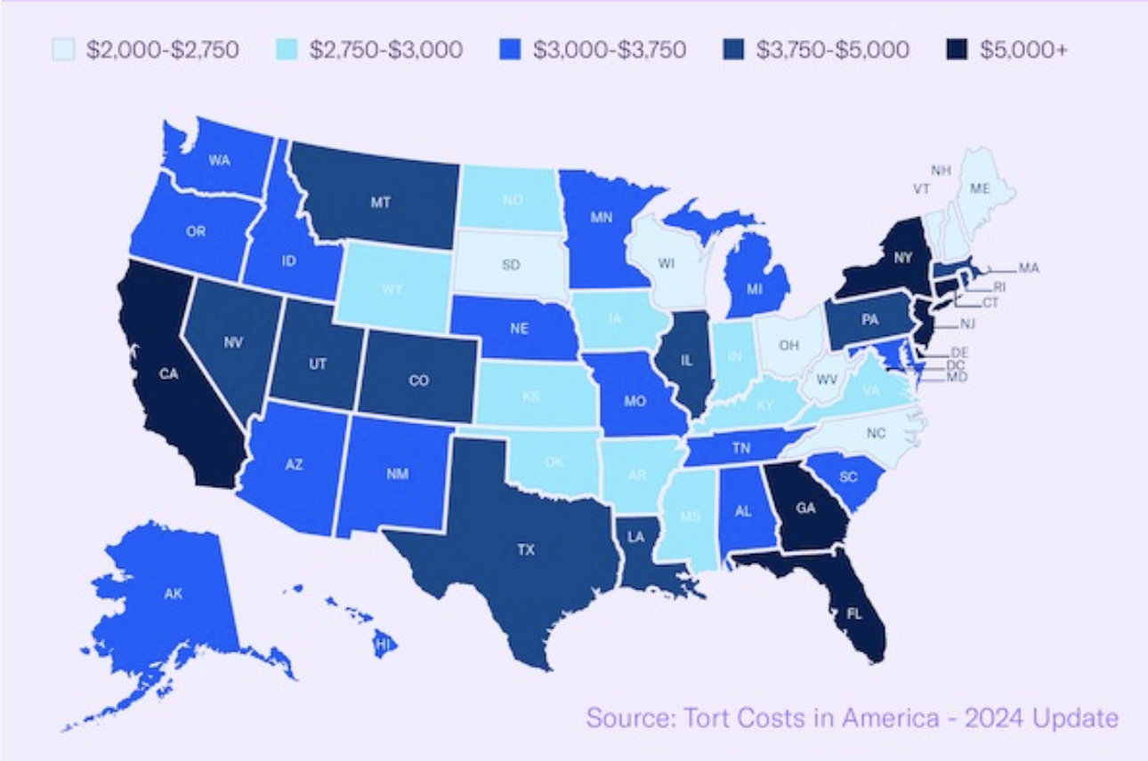
Litigation Tax

Slide 28
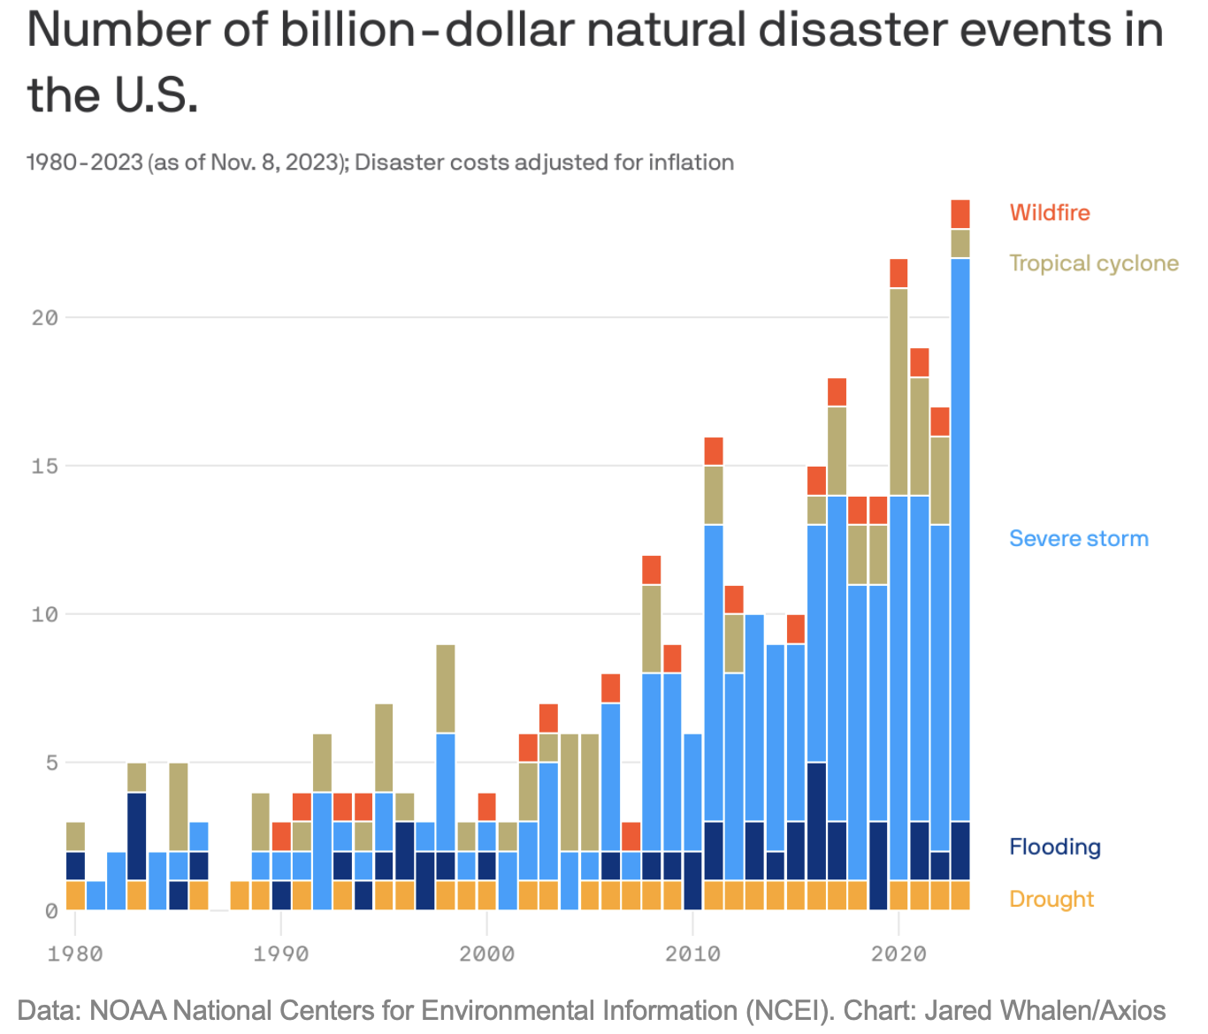

Slide 29
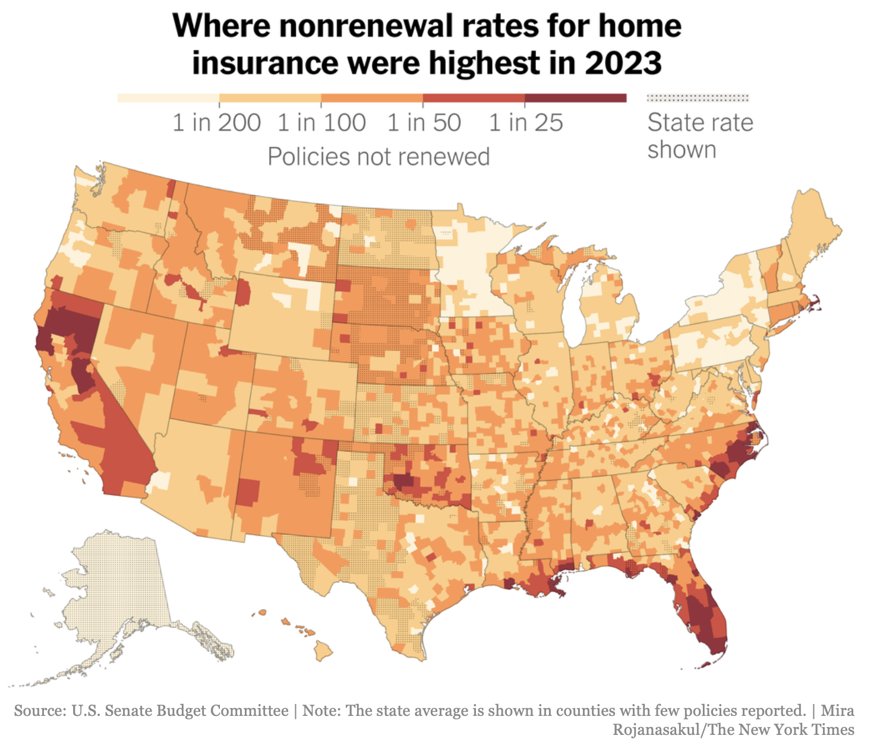

Slide 30
Safety
Fall Fatalities increased 52.7% from 2011-2022 (260 >>397)
Rate increased too, up 13.3%
Smaller companies most impacted

Slide 31
400
x 10
x 150%
_____
6,000

Slide 32
6,000 lives lost to suicide
Construction:
vs
400 lives lost to falls

Slide 33
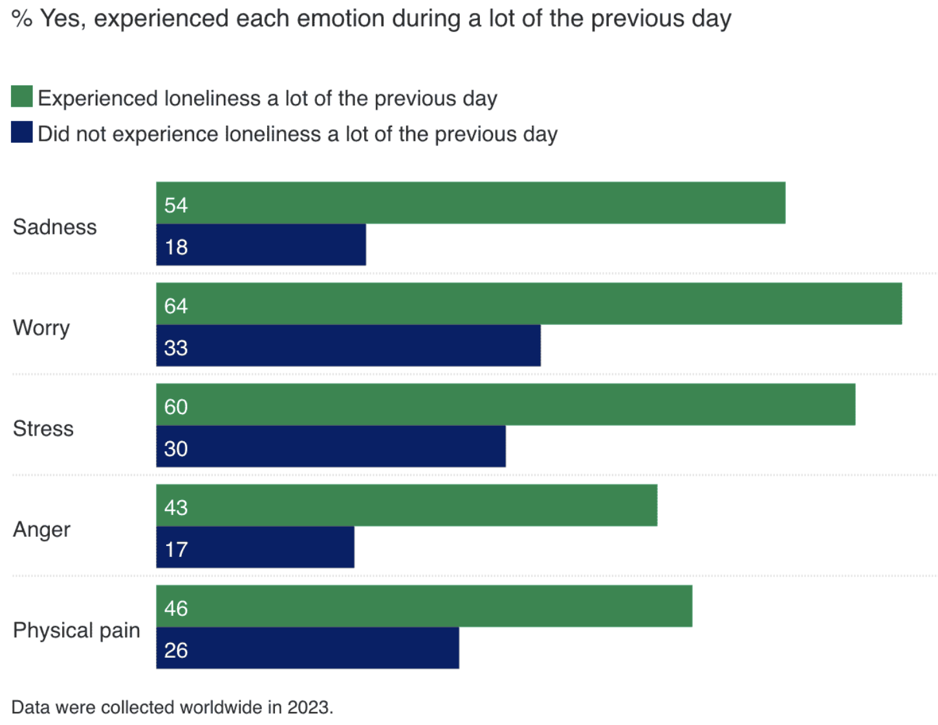

Slide 34
% of US suicides occurred in construction
18%

Slide 35
Even though construction accounts for… 7.5% of the population
18% of loss

Slide 36
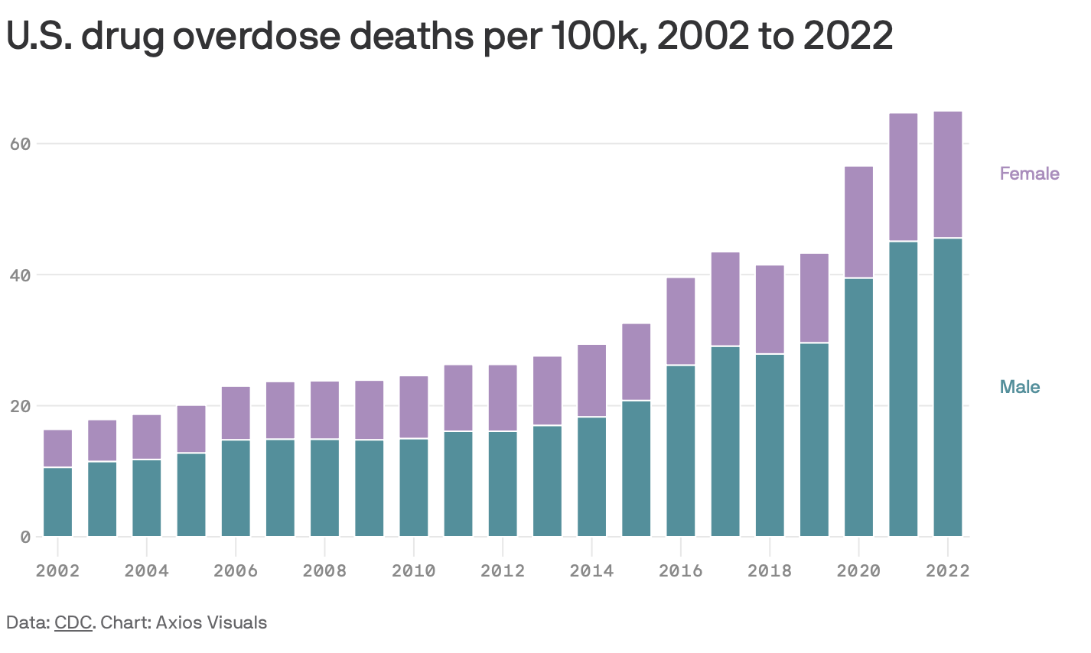

Slide 38
MDaniels@NRCA.Net Cell: 702-510-8605

